Slide 1
Dual Language Best Practices for All
[Presented by: Rubi Flores]
[Union Hill Elementary]

Slide 2
Outline
What does the research say?
Dual Language vs. Early Exit
Core values aligned to Campus Vision
Collaboration: Dual Language Components in mainstream classrooms
Language of the Day
Conceptual Refinement
Content-Area Vocabulary Enrichment Activities
Bilingual Pairs/Bilingual Groups
Bilingual Learning/Research Centers
Student Generated Alphabet
Content Focused Word Walls
Group Project
Reflections

Slide 3
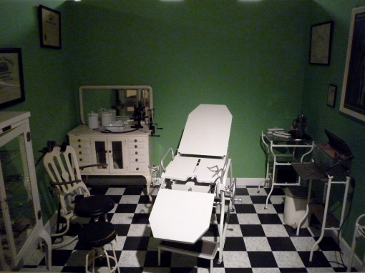
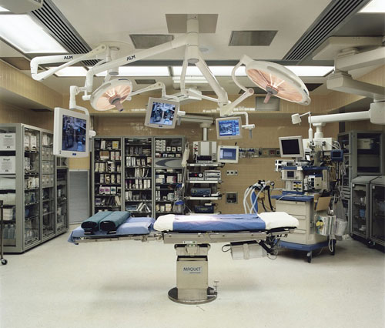
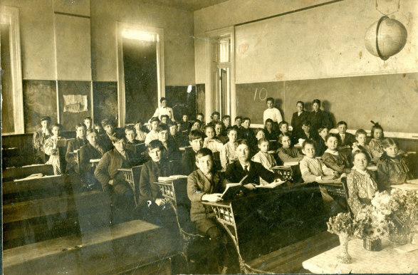
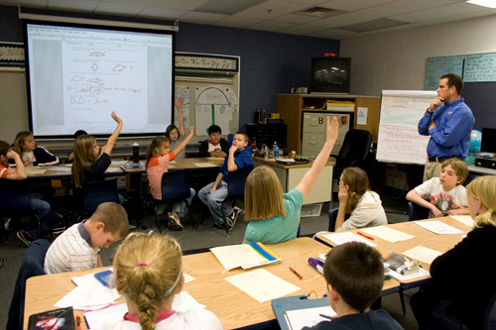
Research…
How did we go from:
Here to Here

Slide 4
Dual Language Vs. Early Exit
What were we doing before?
Early Exit:
Literacy instruction in 1st Language
Math, Science, Social Studies language of instruction up to campus decision
Social Language is English
Transition to English instruction as soon as possible
1st language is eliminated
What are we doing now?
Dual Language:
Literacy instruction in native language k-1
Literacy instruction in English and Spanish 2-5
Math taught in English, Science/Social Studies in Spanish
Academic Vocabulary enrichment activities
1st and 2nd languages are maintained and developed
Brainstorm with a partner: Which program reflects the research? Create a list to justify your answer.

Slide 5
Brainstorm
__________ reflects the research because…
1.
2.
3.

Slide 6
Dual Language Core values aligned to Campus Vision
Dual Language:
Provide the educational environment and instruction that will allow all students to become bilingual, bi-literate and bicultural. Develop fluency in communication and literacy in both English and Spanish. Increase academic achievement in all subject areas. Fostering an appreciation and understanding of other cultures while developing positive attitudes among students, their families, and community
Campus Vision
Union Hill Elementary is a safe, supportive and nurturing community
where all students become inspired, self-motivated and continuous learners

Slide 7
T-Chart
Alike | Different

Slide 8
Collaboration
Same Goals, same vision
Same Best Practices

Slide 9
Language of the Day
Monday, Tuesday, Wednesday: Spanish Days
Tuesday and Thursday: English Days
Classroom is labeled and color coded.
Students practice calendar, morning routines in language of the day.

Slide 10
Conceptual Refinement
Teacher observes students during independent practice
Teacher identifies students who are in need of additional support
Teacher pulls students into a small group and reteaches the concept

Slide 11
Vocabulary Enrichment Activities
Creates connections between first and second language. The concepts are presented in the opposite language to allow students to learn academic vocabulary in both languages
K-2
3-5
Morning Message
Read the room
Read alouds
Review bilingual alphabet
Vocabulary games
Read the room
Weekly vocabulary enrichment games per subject
Journaling
Review bilingual alphabet

Slide 12
Bilingual Pairs/Groups (up to 4)
Students are paired up with a partner during most of the day. Pairs are created according to language proficiency and academic capacity. Group/pair turns in one assignment.
low-medium, medium high
Zone of Proximal Development
More knowledgeable other supports and challenges partner
Promotes collaboration
Gives everyone an opportunity to participate
Lowers anxiety

Slide 13
Bilingual Centers/ Research Centers
Bilingual centers are content specific activities that reinforce academic language development
Bilingual research centers are content specific inquiry projects that students conduct using resources available in both languages.
Games, or activities
Bilingual pairs at each activity
Available in both languages
Integrated across subjects
Requires interaction and use of vocabulary
One set of materials per game
Not an activity for free time
Students choose topic from classroom brainstorm ideas
All students create a product to share their findings
Teacher facilitates by providing minilessons

Slide 14
Student Generated Alphabet
Alphabet displayed in the classroom. Students choose the words to be displayed and illustrate the meaning.
Alphabet is reviewed as a vocabulary enrichment activity
Alphabet changes through out the year
Is used as a learning tool
Can eventually become content specific

Slide 15
Content Focused Word Banks
Teacher creates a word bank for each subject. Walls change as new topics are introduced. Anchor charts can be part of these walls
Students review words as a vocabulary enrichment activity
Become a resource for students when writing about the topic
Previous words can be used in bilingual centers or research centers

Slide 16
Classroom Connection
Each table will be a group.
Make sure you have a bilingual teacher at your table, they will be your resource for today
Complete the tasks in your project sheet
Prepare a quick 5 minute presentation for the rest of the staff

Slide 17
Reflection
In a web browser type in:
www.wallwisher/wall/uhecollaboration.com
Write your answer the following question:
In Spanish
What are some benefits of implementing these components in a mainstream classroom?

Slide 18
Closing Thoughts
Share your reflections
Questions?

