Slide 1
Unit 2: Literary Text: Poetry
Writing Street View • First Grade Spanish
Weeks 24-29
Incorporating and identifying culturally relevant literature into the A.I.S.D. road map for bilingual learners as related to poetry

Slide 2
Workshop Objective
Our objective is to address the issue of standardizing the curriculum too much by focusing on the state curriculum without taking into consideration students backgrounds when creating lesson plans.
These lesson plans are often not culturally relevant for minority students nor address some of the special needs in terms of time and scaffolding through zone of proximal development.

Slide 3
Although this training is geared towards pk-2nd grade, it will also benefit the upper grades in the conceptualization of Culturally Relevant Literature and pedagogy.
The curriculum website has a handout named “teacher Resources” on: http://www.austinschools.org/curriculum/la/resources/documents/LA_PoetryStudyModule.pdf
The handout specifically addresses 3rd – 5th grades and focuses on STAAR strategies and concepts.
The handout recommends Colorin Colorado for more tips on reading poetry with ELLs.

Slide 4
A Magical Encounter
“All children have the right to retain, develop, and enrich their heritage language while learning a national language. Education is about addition and enrichment, not subtraction or reduction. When a child abandons, rejects, or loses the home language from lack of appreciation of that language on the part of school and community, full communication between parents and children may be impaired. This in turn may alienate the child from the many opportunities of human growth and certainly greater opportunities to work on behalf of humanity. (8, Alma Flor Ada)

Slide 5
Educating Emergent Bilinguals
“Important in Cummins’s conceptualization is the intercultural aspect. That is , this transformative /intercultural pedagogy not only authorizes language minority students to engage in collaborative critical inquiry, but by affirming their cultural practices this pedagogy also recognizes their knowledge and identities. Thus, the process is transformative and intercultural, including majority and minority children and affecting the school culture and society in general (Garcia & Kleifgen, 75)

Slide 6
Educating Emergent Bilinguals
“ Besides aligning classroom experiences with the student’s home languages and cultures, culturally relevant pedagogies attempt to counteract inequitable power relations in society and empower minority students to develop their literacy and agency to work against oppression (Freire, 1970: Giroux, 1988).

Slide 7
Authors in the Classroom, A Transformative Education Process
“Whereas the school may emphasize “book culture”, the home may share and transmit wisdom in a different way. Because schools emphasize the value of books, it is the school’s responsibility to ensure that the students’ families and communities are fully represented in those books, that they are inclusive rather than exclusionary” (Flor Ada & Campoy, 33).

Slide 8
Based on the previous citations, do you think the poetry resources from the Teacher Resources from 3rd to 5th grade are culturally relevant?
Poets.org
http://www.gigglepoetry.com/
See http://www.colorincolorado.org/ for more tips on reading poetry with ELLs.
http://www.missspott.com/figurativelanguage.html
http://www.tooter4kids.com/forms_of_poetry.htm
http://www.poemsforchildren.org/
The Children’s Poetry Archive

Slide 9
Based on the previous citations, do you think the poetry resources from the road map from 1st grade are culturally relevant for ELLs?
Mentor Texts:
Shel Silverstein Collections
Jack Prelutsky Collections
Kenn Nesbitts Collections
Additional Resources:
The Conferring Handbook by Lucy Calkins
Poetry: Powerful Thoughts in Tiny Packages by Lucy Calkins and Stephanie Parsons
Websites:
  http://www.mamalisa.com/?p=533&t=ec&c=71
  www.poetry4kids.com
  www.effectiveteachingsolutions.com/poetrywebsites.htm

Slide 10
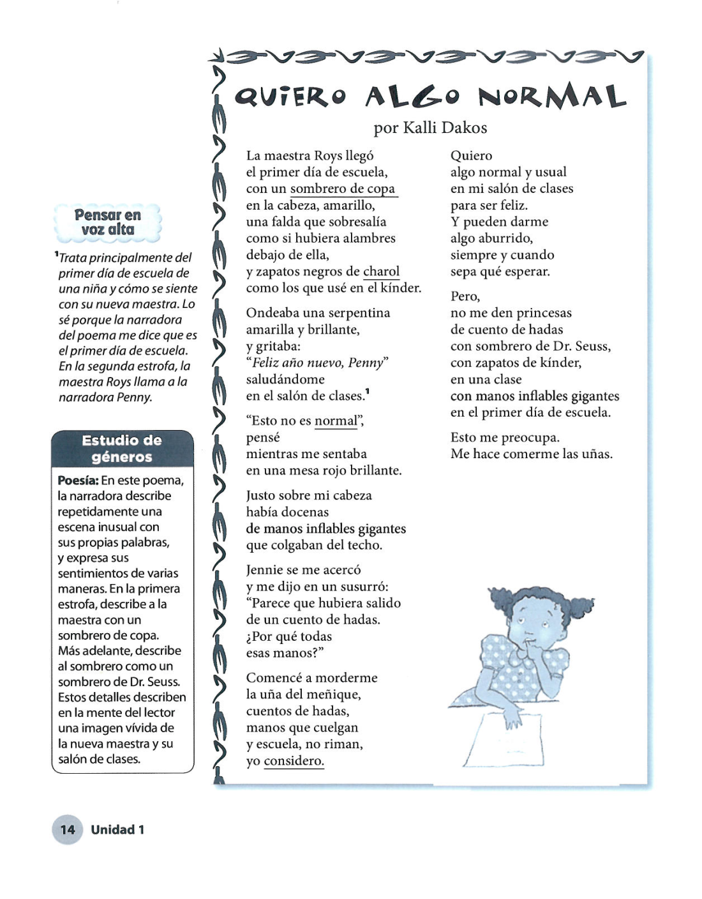
Do you think this poem in Spanish is culturally relevant? Why or why not? (From Teacher Resources 3rd to 5th grade)

Slide 11
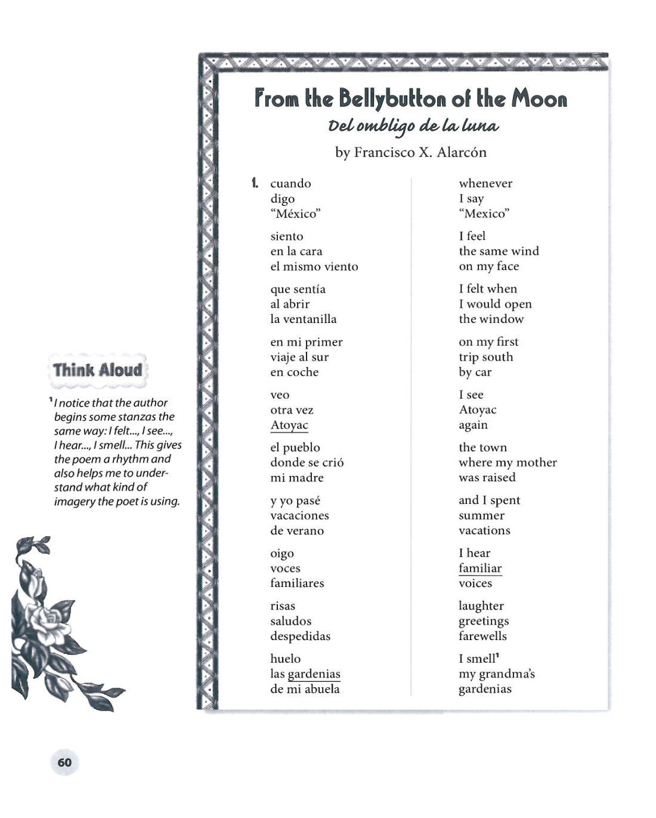
Do you think this poem in Spanish is culturally relevant? Why or why not? (From teacher resources 3rd to 5th grade)

Slide 12
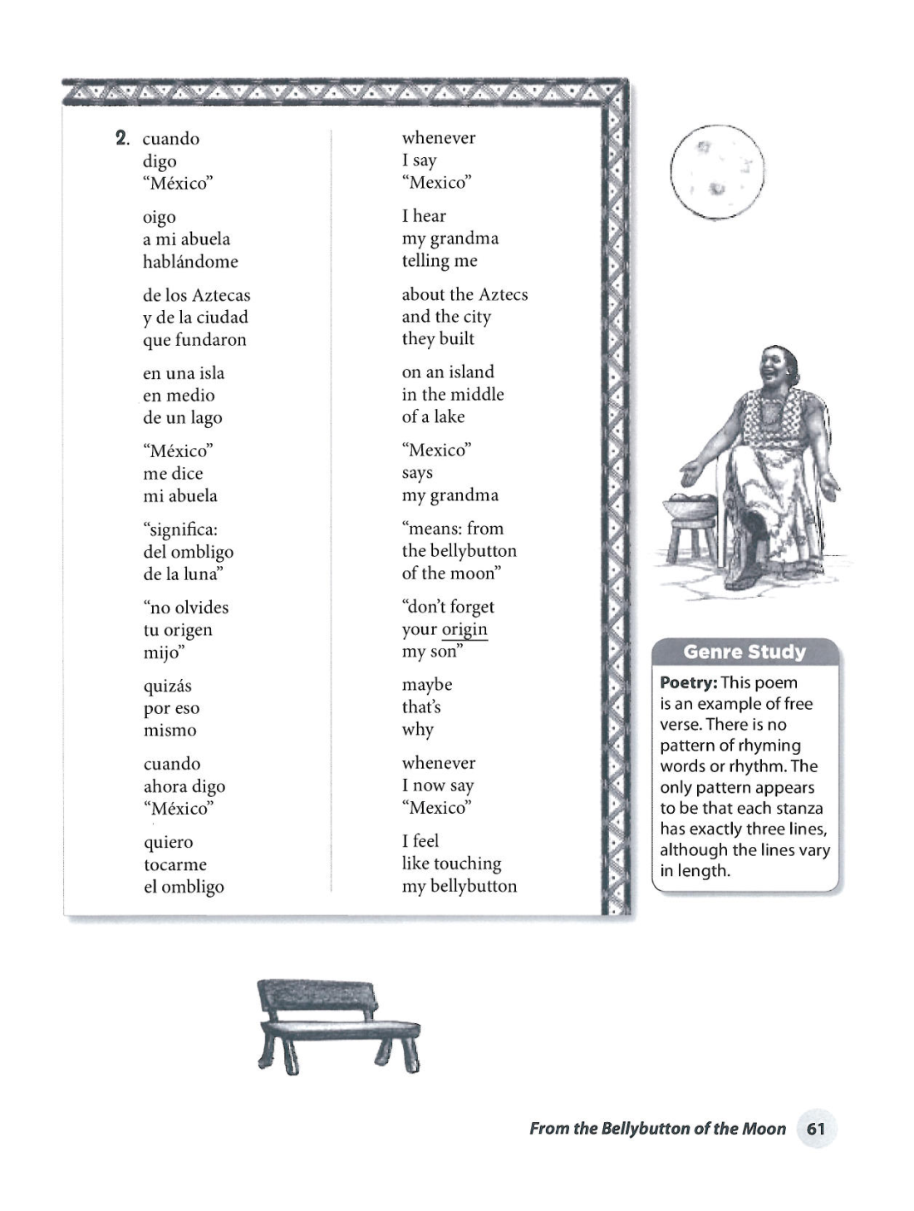

Slide 13
Mini-Lesson 17: Seeing with Poet’s Eyes | Mini-Lesson 18: Seeing with Poet’s Eyes
1. Tell students that toady we are beginning a new writing project. Tell them that this unit will be slightly different from other units because we will be studying and writing a special genre called poetry. If you have read poems throughout the year, share those again with students drawing attention to the fact that students are already familiar with a few poems. 2. Tell them one reason you love poetry so much is that poets often see everyday objects in a new, fresh way. 3. Show the students a pencil sharpener. Share with them Zoe Ryder White’s Poem written on chart paper. Highlight how Zoe saw this object in such an interesting, exciting way! Active Engagement: 4. Ask students how they would see an everyday object in a new way using their “poet’s eyes.” 5. Have students look at the ceiling and describe it in a fresh, interesting way. 6. Share Zoe’s poem titled Ceiling. Again draw attention to how she saw an everyday object with fresh eyes. 7. Enforce that in poetry we look at things in new ways. We look with our eyes but we also look with our heart and mind. 8. Place everyday objects around the room. Send students off to write (or draw) about everyday objects. Teacher may want to consider modeling this process through drawing. | 1. Remind students that yesterday we began looking at everyday objects with poet’s eyes. 2. Tell them today we are going to continue to look at objects in fresh ways. Show students a safety pin. On chart paper, create a T-chart labeled scientist’s notes and poet’s notes. 4. List how a scientist would see this object in very obvious simple ways (i.e. grey, small, metal, sharp, round part). 5. Then read aloud Valerie Worth’s poem Safety Pin. After have students help you list how a poet saw the safety pin. Active Engagement 4. Allow students to examine more everyday objects with poet’s eyes. 5. Mid way, stop students. Congratulate them for using their poet’s eyes. However, encourage them to slow down and only look at one object closely. Share/Reflect Choose some students to share their discoveries with the whole group. Safety Pin By Valerie Worth Closed, it sleeps On its side Quietly, The silver Image Of some Small fish; Opened, it snaps Its tail out Like a thin Shrimp, and looks At the sharp Point with a Surprised eye.

Slide 14
Mini-Lesson 17 Modified | Mini-Lesson 18: Modified
1. Tell students that today we are beginning a new writing project. Tell them that this unit will be slightly different from other units because we will be studying and writing a special genre called poetry. If you have read poems throughout the year, share those again with students drawing attention to the fact that students are already familiar with a few poems. 2. Tell them one reason you love poetry so much is that poets often see everyday objects in a new, fresh way. Tell them that traditional poems in Spanish often are also songs that are learned generation after generation through family oral traditions. 3. Show the students a picture of a rat. Share with them Una Rata Vieja on chart paper. Highlight how the author saw this object in such an interesting, exciting way! 4. Sing the verses of Una Rata Vieja with the students. Active Engagement: 4. Ask students how they would see an everyday object in a new way using their “poet’s eyes.” 5. Have students look at a picture of a snake and describe it in a fresh, interesting way. 6. Share A la Vibora de la Mar. Again draw attention to how the author saw an everyday object with fresh eyes. 7. Enforce that in poetry we look at things in new ways. We look with our eyes but we also look with our heart and mind. 8. Enact the verses with the students :http://en.wikipedia.org/wiki/La_v%C3%ADbora_de_la_mar 8. Place everyday objects around the room. Send students off to write (or draw) about everyday objects. Teacher may want to consider modeling this process through drawing. | 1. Remind students that yesterday we began looking at everyday objects with poet’s eyes. 2. Tell them today we are going to continue to look at objects in fresh ways. Show students a picture of the sun, or a sun from the solar system form science. On chart paper, create a T-chart labeled scientist’s notes and poet’s notes. 4. List how a scientist would see this object in very obvious simple ways (i.e. made of gas, big, in space, round, yellow, red). 5. Then read aloud SOL DE MONTERREY de Alfonso Reyes. After have students help you list how a poet saw the sun. Active Engagement 4. Allow students to examine more everyday objects with poet’s eyes. 5. Mid way, stop students. Congratulate them for using their poet’s eyes. However, encourage them to slow down and only look at one object closely. Share/Reflect Choose some students to share their discoveries with the whole group. 6. Suggest that students ask their parents about songs or poems that they learned at home when they were children. Ask them to teach them to the students and bring them to the classroom to share.

Slide 15
A la Víbora de la Mar
A la víbora, víbora
de la mar, de la mar
por aquí pueden pasar
Los de adelante corren mucho
y los de atrás se quedarán
tras, tras, tras, tras.
Una Mexicana que fruta vendía
ciruela, chabacano, melón y sandía.
Será melón, será sandía
será la vieja del otro día
día, día, día, día
El puente esta quebrado
que lo manden componer
Con cascaras de huevo
y pedazos de oropel
pel, pel, pel, pel

Slide 16
Una Rata Vieja
Una rata vieja que era planchadora
por planchar su falda se quemó la cola
se puso pomada y se amarró un trapito
y a la pobre rata le quedó un rabito
lero lero lero
lero lero la
esa rata vieja no sabe planchar.

Slide 17
SOL DE MONTERREY
Alfonso Reyes
No cabe duda: de niño,
a mí me seguía el sol.
Andaba detrás de mí
como perrito faldero;
despeinado y dulce,
claro y amarillo:
ese sol con sueño
que sigue a los niños.
Saltaba de patio en patio,
se revolcaba en mi alcoba.
Aun creo que algunas veces
lo espantaban con la escoba.
Y a la mañana siguiente,
ya estaba otra vez conmigo,
despeinado y dulce,
claro y amarillo:
ese sol con sueño
que sigue a los niños.
(El fuego de mayo
me armó caballero:
yo era el niño andante,
y el sol, mi escudero.)
Todo el cielo era de añil;
Toda la casa, de oro.
¡Cuánto sol se me metía
por los ojos!
Mar adentro de la frente,
a donde quiera que voy,
aunque haya nubes cerradas,
¡oh cuánto me pesa el sol!
¡Oh cuánto me duele, adentro,
esa cisterna de sol
que viaja conmigo!
Yo no conocí en mi infancia
sombra, sino resolana.-
Cada ventana era sol,
cada cuarto era ventanas.
Los corredores tendían
arcos de luz por la casa.
En los árboles ardían
las ascuas de las naranjas,
y la huerta en lumbre viva
se doraba.
Los pavos reales eran
parientes del sol. La garza
empezaba a llamear
a cada paso que daba.
Y a mí el sol me desvestía,
para pegarse conmigo,
despeinado y dulce,
claro y amarillo:
ese sol con sueño
que sigue a los niños.
Cuando salí de mi casa
con mi bastón y mi hato,
le dije a mi corazón:
-¡Ya llevas sol para rato!-
Es tesoro – y no se acaba:
no se acaba – y lo gasto.
Traigo tanto sol adentro
Que ya tanto sol me cansa.-
Yo no conocí en mi infancia
Sombra, sino resolana.

Slide 18
Extra resources
http://lectura.dgme.sep.gob.mx/esl_ibby_00.php
http://lectura.dgme.sep.gob.mx/cdc_mda_02.php
http://www.librosalfaguarainfantil.com/es/
http://www.latinoteca.com/arte-publico-press/pinata-books
http://www.cri-cri.net/Canciones/canciones.html
http://www.colorincolorado.org/read/forkids/
http://bibliotecadigital.ilce.edu.mx/sites/litinf/index.htm

Slide 19
Suggested books/websites/authors

